Slide 1
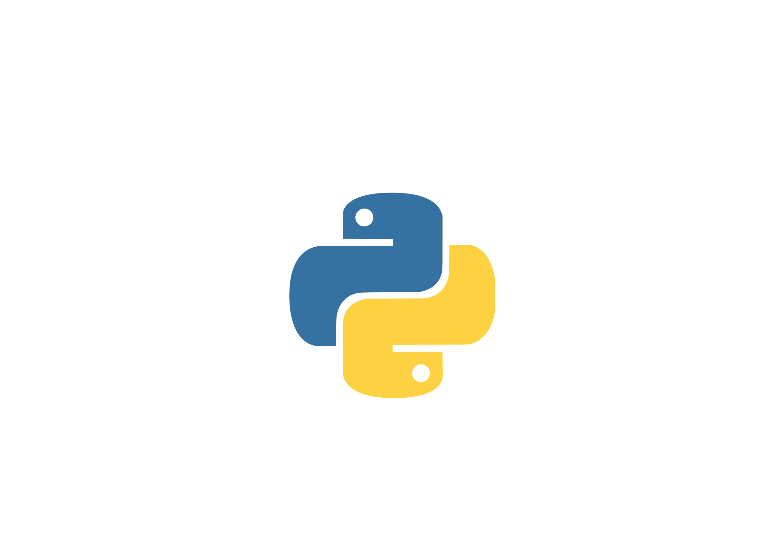
Functions

Slide 2
Function in Python
Block of organized, reusable code that is used to perform a single, related action
High degree of code reusing
Easy to break down the large programs into smaller and modular chunks
Easy to organize and manage larger programs
Types of functions in Python:
Built-in functions
User-defined functions
There are many built-in functions in Python, and we can create our own custom functions

Slide 3
Defining a Function
def <function_name>([<parameters>]): <statement(s)>
Syntax for defining function is as:
There are certain rules we need to consider while defining a function, which is described in next slide.
Component | Meaning
def | The keyword that informs Python that a function is being defined
<function_name> | A valid Python identifier that names the function
<parameters> | An optional, comma-separated list of parameters that may be passed to the function
: | Punctuation that denotes the end of the Python function header (the name and parameter list)
<statement(s)> | A block of valid Python statements

Slide 4
Defining a Function (rules)...
Rules which need to be considered while defining a function:
Function block starts with keyword 'def' followed by the function name and parenthesis (()). (function naming follows the rule of identifier naming, explained in the python basics)
Parameters(arguments) are optional and should be placed within the parenthesis if used.
Code block within every function starts with colon (:) and block itself is indented.
Docstring of a function is optional
The return statement is optional
>>> # defining a function
>>> def message(text):
... print(f"This is {text} from the function")
...
>>>print(message(“I study python”))

Slide 5
How to do function call?
First, the function must be defined then we can call it.
To make a function call, write the function's name followed by (), placing any required arguments within the brackets.
Syntax for calling a function in Python:
<arguments> are the values passed into the function.
They correspond to the <parameters> in the Python function definition.
You can define a function that doesn’t take any arguments, but the parentheses are still required.
While calling a function, If function returns expression or value then we can keep them in a variable. (We will have a look in next slide)
<function_name>([<arguments>])

Slide 6
Function call in Python (example)...
In this example we will call the function that doesn't use return statement
>>> # defining a function
>>> def message(name):
... print("Hello, " + name + ". How are you?")
...
>>> # calling a function
>>> r = message('John’)
Print(r)
Hello John. How are you?

Slide 7
return statement in a Function
Used to exit a function and go back to the place from where it was called.
Syntax:
If return statement is not present in a function or if there is no expression in the statement (ie. just return keyword only) then the function will return None object.
Since there is no return statement with expressions used in function func, it will return None. And we are getting the 'Hello, Jane' as statement inside of loop and None as the outer print on the function call.
return [expression]
>>> # defining a function
>>> def func(name):
... print("Hello,", name)
...
>>>print(func('Jane'))
Hello, Jane
None

Slide 8
return statement (example)...
>>> def add(a, b):
... return a+b
...
>>> print(add(2, 3))
5
>>>
>>> result = add(4, 3) # keeping the returned value in a variable
>>> print(result)
7

Slide 9
Function Arguments

Slide 10
Function Arguments
We can pass one or more numbers of data as an argument while defining functions.
The arguments can be objects, variables and functions.
The different types of formal arguments we can use:
Positional Argument Values
Keyword / Default Arguments
Arbitrary Argument Lists
x and y are defined parameters
>>> def example(x, y):
... print(x, y)
...
>>> example('Argument', y='Example')
Output:
Argument Example
Passing values as an arguments

Slide 11



Order of defining Arguments
The order of defining parameter in function are :
1. positional parameter or non-default parameter i.e. (sum, total, data, user)
2. keyword parameter or default parameter i.e. (sum="50", user="mark")
3. keyword-only parameter i.e. (*args)
4. var-keyword parameter i.e. (**kwargs)
Keyword arguments must follow positional arguments.
We can't define (x="value", c) in function, where c is a positional argument.
Error Alert:
>>> def order(x='value', c):
... print(x, c)
...
File "<stdin>", line 1
SyntaxError: non-default argument follows default argument
Correct way:
>>> def order(c, x='value'):
... print(c, x)
def example(sum, total, user, count=0 , array=[], *args, **kwargs):

Slide 12

Example for ordering arguments..
>>> def show_argument_types(sum, total, user, count=0, array=[], *args, **kwargs): ... print("The sum is: ", sum) ... print("The total is: ", total) ... print("The user name is: ", user) ... print("The count is: ", count) ... print("New array is: ", array) … print("Arguments: ") ... for each in args: ... print(each) ... print("Key word Arguments: ") ... for key in kwargs: ... print(key, ":", kwargs[key])
Positional Arguments
>>> show_argument_types(100, 1000, 'Ram', 7, ['blue', 'white'], 'Insight Workshop', 'Academy', address="Kamal Pokhari", year=2020) Output: The sum is: 100 The total is: 1000 The user name is: Ram The count is: 7 New array is: ['blue', 'white'] Arguments: Insight Workshop Academy Key word Arguments: address : Kamal Pokhari year : 2020
Var-Keyword Arguments
(*kwargs)
Keyword Arguments must follow Positional Arguments
Keyword only Arguments (*args)

Slide 13
Default Argument Values
The most practical way is to set out a default value for arguments.
Default values are used if no argument value is passed during a function call.
The default value is assigned by using assignment(=) operator of the form keyword=value.
In an example a function named welcome can be called in various ways.
Specifying only the mandatory argument for user variable: Here, default argument value is 1.
Specifying optional or all arguments for attempt variable. Here, default value 1 is replaced by 2.
>>> def welcome(user, attempt=1): ... if (attempt==1): ... print('Welcome ' + user + ' It is your first login') ... else: ... print('Welcome back ' + user) ... >>> welcome('Username') Welcome Username It is your first login >>> welcome('Username',2) Welcome back Username
welcome('Username')
welcome('Username', 2)

Slide 14
Keyword Arguments
Functions can be defined using keyword arguments of the form kwargs=value.
>>> def user_data ( user, group, role='Python Developer', id='4'): ... print(id + '. ' + user + ' of ' + group + ' group' + ' has a role of ' + role) ... >>> user_data(user='Ram', group= 'Admin') Output: 4. Ram of Admin group has a role of Python Developer
This function accepts two mandatory arguments (user, group) and
two optional arguments (role, id)
Two keyword arguments
The order (position) of the keyword arguments can be changed. It produces same output.
>>> user_data(group= 'Admin', user='Ram') 4. Ram of Admin group has a role of Python Developer

Slide 15
Arbitrary Argument Lists
Arbitrary means unpredictable.
Function can be called with an arbitrary number of arguments. That means we are unknown of the exact numbers.
We use an asterisk (*) before the parameter name such as *args, *names, etc.
>>> def books(*categories): ... for category in categories: ... print(category) ... >>> books('Fiction', 'Technical', 'Non-Fiction', 'Programming') Fiction Technical Non-Fiction Programming
The arguments are wrapped up in a tuple before being passed into the function.

Slide 16
More on Python Functions
Functions in Python are first-class citizens.
Properties of first-class functions are:
Functions are objects
Functions can be stored in data structure
Functions can be passed to other functions
Functions can be nested

Slide 17
Functions are objects
We will assign the function func to the variable greet.
The assignment won't call the function, instead it will take the function object referenced by func and creates a second name, greet, that points to it.
Now you can execute the same underlying object by calling greet.
>>> def func(name):
... return 'Hello ' + name.upper() + '.'
>>> greet = func
>>> greet('John')
Hello JOHN.

Slide 18
Functions can be stored in data structure
Just like with other Python objects, you can store functions in a data structure.
>>> def func(name):
... return 'Hello ' + name.upper() + '.'
>>> funcs = [func, str.title, str.lower]
[<function func at 0x7fb7704393a0>,
<method 'title' of 'str' objects>,
<method 'lower' of 'str' objects>]

Slide 19
Functions can be stored in data structure...
>>> def func(name):
... return 'Hello ' + name.upper() + '.'
>>> funcs = [func, str.title, str.lower]
>>> for f in funcs:
... print(f, f('John')
<function func at 0x7fa75edf83a0> Hello JOHN.
<method 'title' of 'str' objects> John
<method 'lower' of 'str' objects> john
>>> funcs[0]('John')
'Hello JOHN.'

Slide 20
Functions can be passed to other functions
In Python, functions are object and just like other objects functions can be passed as arguments.
When we pass func to the greet function:
>>> def func(name): # normal function with name as argument
... return 'Hello ' + name.upper() + '.'
>>> def greet(my_func): # function with another function as argument
... message = my_func('Jane') # calling the passed function
... print(message)
>>> greet(func)
'Hello JANE.

Slide 21
Functions can be passed to other functions...
Functions that can accept other functions as arguments are also known as higher-order function.
The traditional example for higher-order functions in Python is the built-in map function. (We will cover in Python lambda functions)

Slide 22
Functions can be nested
Functions can be defined inside other functions
Nested functions are also called the inner functions
>>> def get_greet_message(current_time):
...
... def morning(name):
... return 'good morning ' + name
...
... def afternoon(name):
... return 'good afternoon ' + name
...
... if current_time < 12:
... return morning
... else:
... return afternoon
...

Slide 23
Functions can be nested ...
Function definition is used from the previous slide
Every time you call get_greet_message function, it defines two inner functions morning and afternoon.
And selects the appropriate inner function based on the current_time argument and return the function object
We can make function call on so returned function.
>>> greet_func = get_greet_message(13)
>>> greet_func
<function get_greet_message.<locals>.afternoon at 0x7f5d9010f8b0>
>>> greet_func('Jane')
'good afternoon Jane'

Slide 24
Python Anonymous/Lambda Function

Slide 25
Introduction
lambda function is a small anonymous function
Uses lambda keyword
Anonymous functions are defined without a name
Syntax:
Lambda functions can have any number of arguments, but are syntactically restricted to a single expression
lambda arguments: expression

Slide 26
Examples:
>>> sqr = lambda x: x**2
>>> print(sqr(4))
16
Here, x is the argument and x**2 is the expression
It is same as:
>>> def sqr(x):
... return(x**2)
>>> sprint(sqr(2))
16

Slide 27
Examples:
>>> (lambda x: x * 2)(3) 6
>>> add = lambda a, b : a + b
>>> add(2,5)
7
>>> mul = lambda a, b : a * b
>>> mul(2,16)
32
>>> x = lambda a, b, c : a + b * c
>>> x(5,6,2)
17

Slide 28
Python lambda| filter, map, reduce
filter(): built-in function that takes in a function and a list as arguments
It takes a predicate as a first argument and an iterable as a second argument.
The function is called with all the items in the list and a new list is returned which contains items for which the function evaluates to True.
>>>even = lambda x: x%2 ==0
>>>list(filter(even, [1, 2, 3, 4, 5, 6, 7, 8]))
[2, 4, 6, 8]

Slide 29
Example:
>>> x = filter(lambda x: x<10, [1, 2, 13, 24, 15, 6, 67, 28, 3, 7, 9])
>>> print(x)
<filter object at 0x7ff63d9c0f60>
>>> print(list(x))
[1, 2, 6, 3, 7, 9]
Function above uses filter function and lambda, which filters values less than 10
If we print variable x, it shows filter object because filter() function returns filter object, we convert it to a list in the final step
We can write it in a single step as:
>>> list(filter(lambda x: x<10, [1, 2, 13, 24, 15, 6, 67, 28, 3, 7, 9]))
[1, 2, 6, 3, 7, 9]

Slide 30
Python lambda| filter, map, reduce
map(): built-in function that takes in a function and a list as arguments
It takes a predicate as a first argument and an iterable as a second argument.
New list is returned which contains all the lambda modified items returned by that function for each item
>>>sqr= lambda x: x**2
>>>list(map(sqr, [1, 2, 3, 4, 5, 6, 7, 8]))
[1, 4, 9, 16, 25, 36, 49, 64]

Slide 31
Example:
>>>x = map(lambda x: x*2, range(1,4))
>>>print(x)
<map object at 0x7ff63d9c0f60>
>>>print(list(x))
[2, 4, 6]
Function above uses map function and lambda, which maps values from range function (start =1, stop = 4-1) to the lambda function which double the value (x*2)
If we print variable x, it shows map object because map() function returns map object, we convert it to a list in the final step
We can write it in a single step as:
>>> list(map(lambda x: x*2, range(1,4)))
[2, 4, 6]

Slide 32
Python lambda| filter, map, reduce
reduce(): function that takes in a function and a list as arguments, this is a part of functools module
It is called with a lambda function and a list and a new reduced result is returned
This performs a repetitive operation over the pairs of the list
Here the results of previous two elements are added to the next element and this goes on till the end of the list like (((((1+2)+3)+4)+5)+6).
>>>from functools import reduce
>>>add= lambda x,y: x+y
>>>reduce(add, [1, 2, 3, 4, 5, 6])
21

Slide 33
Example:
>>>from functools import reduce
>>>mul= reduce(lambda x,y: x*y, range(2,6))
>>>print(mul)
120
Function above uses reduce function and lambda, which applies the lambda function to range function (start =2, stop = 6-1 and accumulates the result.
Reduced result is returned when the iterable is exhausted, in this case, when it reaches the end of the range i.e 5
Above example works as, (((2*3)*4)*5)

Slide 34
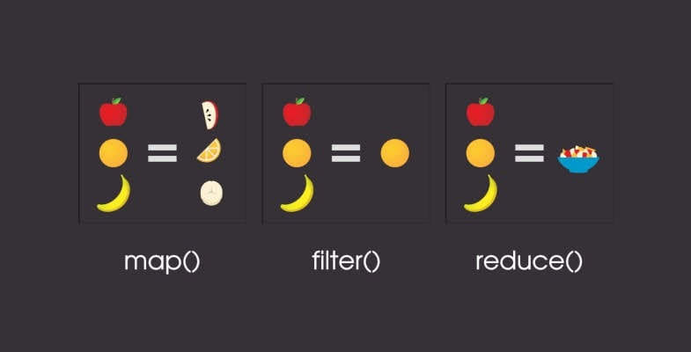
Map, Filter, Reduce in a nutshell

Slide 35
Python Decorators

Slide 36
What are python decorators?
A decorator is a design pattern in Python that allows a user to add new functionality to an existing object without modifying its structure
decorators add functionality to an existing code, which is also called metaprogramming as a part of the program tries to modify another part of the program at compile time
Decorators are usually called before the definition of a function you want to decorate.

Slide 37
Prerequisites for learning decorators:
Functions
Higher-order functions
closures in Python
We have already discussed about functions and higher order functions and now we'll cover closures

Slide 38
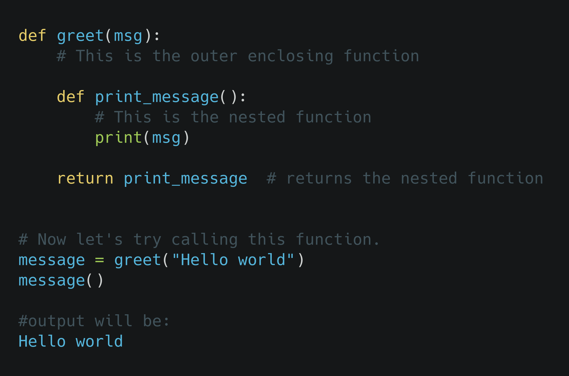
What are python closures?
The greet() function is called with "Hello world" as argument and the returned function is bound to the name message.
On calling message(), the message was still remembered although we had already finished executing the greet() function.

Slide 39
What are python closures?
Closure is a function (object) that remembers its creation environment (enclosing scope).
In this case, "Hello world" gets attached to the code. This is called Python closure

Slide 40
Python closure criteria:
There must be a nested function
The nested function must refer to a value defined in the enclosing function
The enclosing function must return the nested function

Slide 41
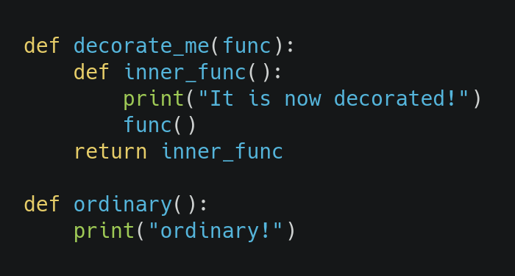
Decorator: breakdown
We have a regular function ordinary() which prints 'ordinary!' When called
We have a decorator function which has an inner function inner_func that calls the function passed as argument in decorate_me
decorate_me() returns inner_func, as discussed in closure.

Slide 42
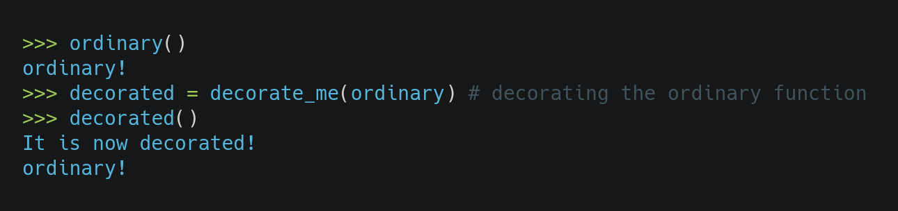
Decorator: breakdown
Here, decorate_me() is a decorator, function ordinary() got decorated and the returned function was given the name decorated.
decorate_me(ordinary) returns a function that we call on the final step to see the decorated result.
We can see that the decorator function added some new functionality to the original function.

Slide 43
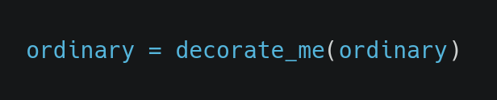
Decorator: breakdown
Generally, we decorate a function and reassign it as,
So that when you call ordinary() it is decorated
This is a common construct and for this reason, Python has a syntax to simplify this.
We can use the @ symbol along with the name of the decorator function

Slide 44
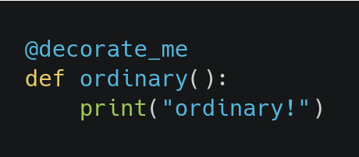
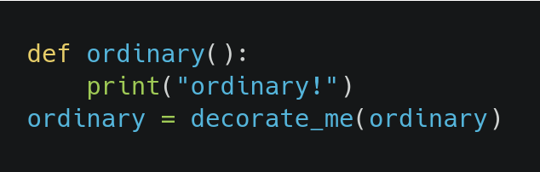
Decorator: breakdown
Above code is equivalent to:

Slide 45
Decorator: breakdown
Above code is equivalent to:

Slide 46
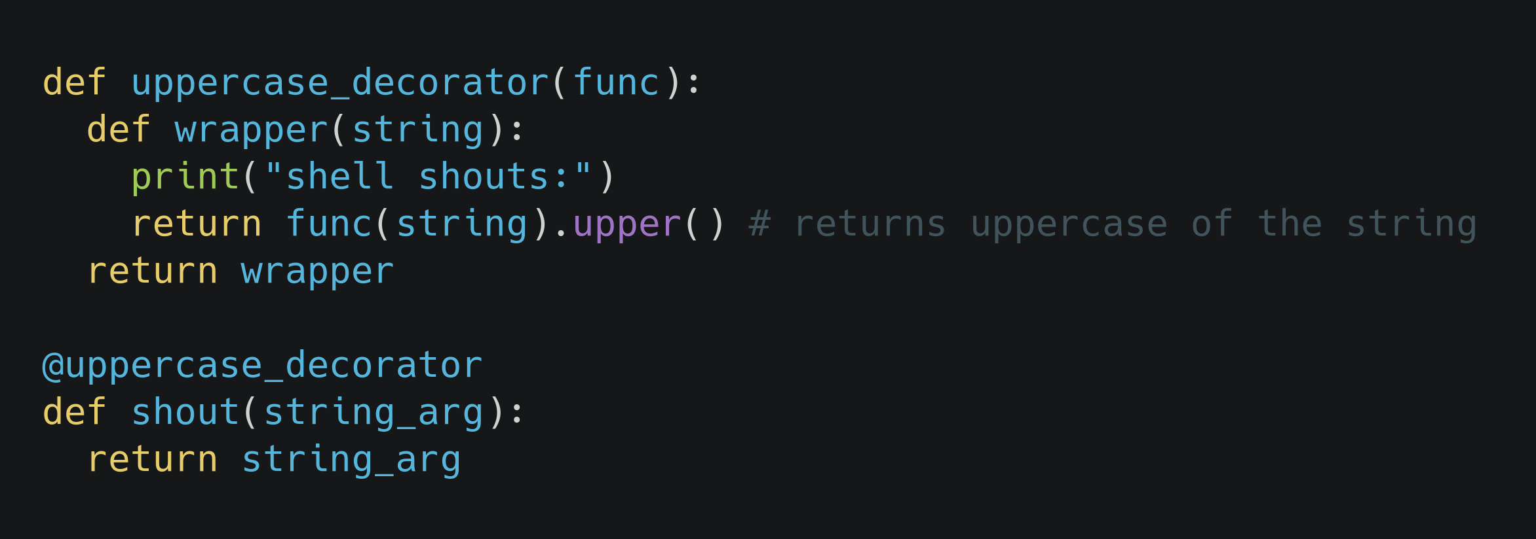
Decorator with argument example:
Our regular function shout() takes one argument
uppercase_decorator is a decorator that prints "shell shouts:" and coverts given string to uppercase.
We have decorated shout() function with uppercase_decorator

Slide 47
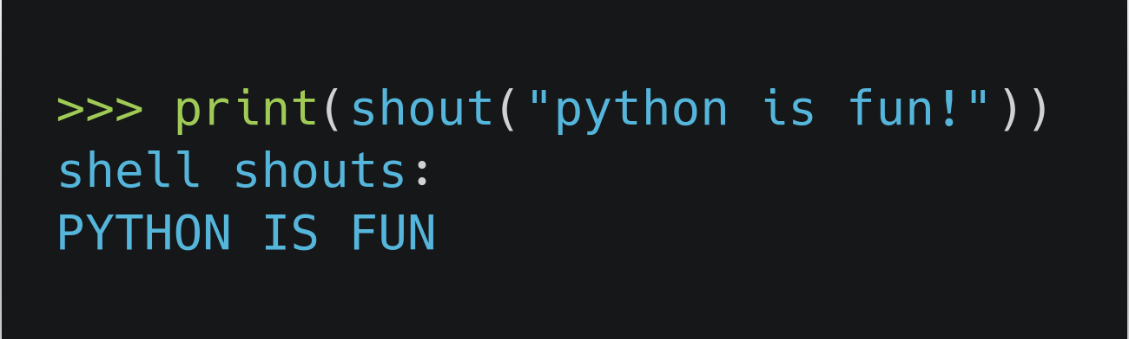
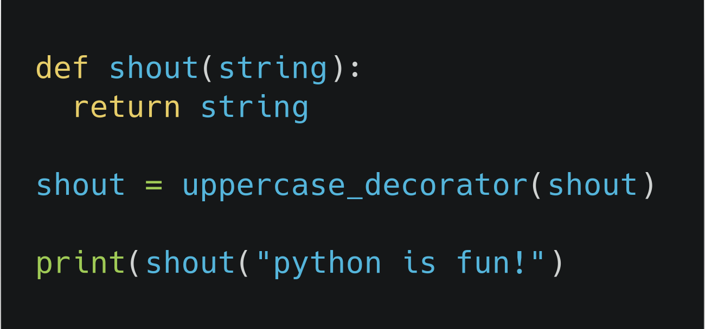
Decorator with argument example:
When we print the result returned from the decorated function, we see it is in uppercase.
If @ was not used, the corresponding function call would be:

Slide 48
Decorator with argument example:
If you look closely, you'll notice that parameters of the nested wrapper() function inside the decorator is same as the parameters of functions it decorates
This allows us to make general decorators that work with any number of parameter.
We can use function(*args, **kwargs), args will be the tuple of positional arguments and kwargs will be the dictionary of keyword arguments.

Slide 49
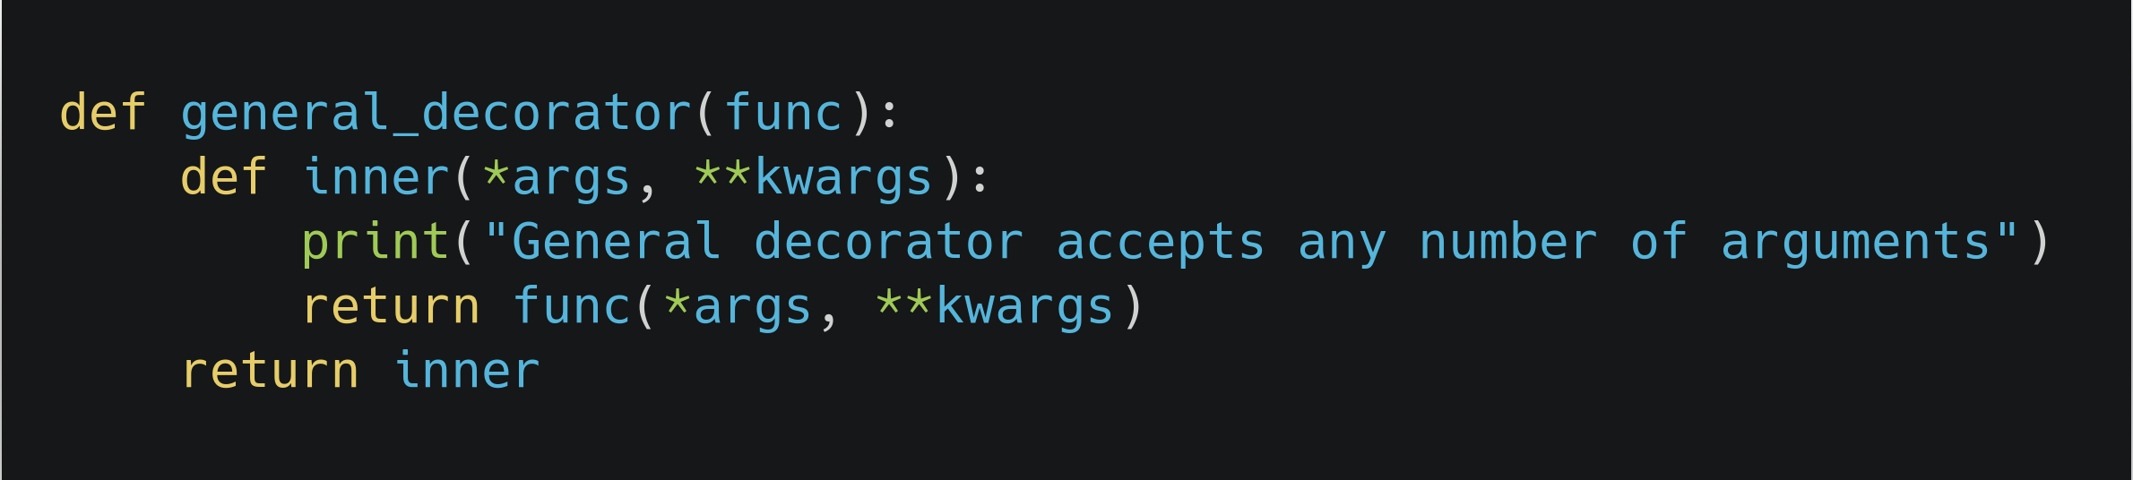
Decorator with argument example:

